Slide 1
Chapter 5: Dynamic Analysis-Test Design Techniques
Software Testing
Use Case Based Testing

Slide 2
Use Case Based Testing
Use Case:
List of steps to achieve a goal
Interaction between the actor and system
Captures functional requirements of the system
Document describing end to end behavior of the system from user perspective
- User Action
- System behavior
It defines the main scenarios (and optional exceptional scenarios)
- Scenario is sequence of events or workflow

Slide 3
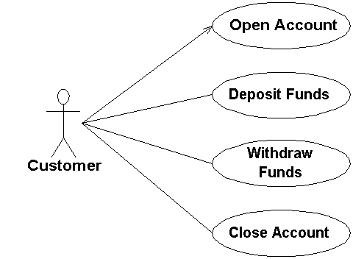
Use Case Elements
Brief description
Actor
Precondition
Basic Flow
Alternate flow
Exception flow
Post Conditions

Slide 4
Use Case Based Testing
Black Box Testing
Tests are designed to execute user scenarios
Helps us to identify test cases that exercise the whole system.
Testing of typical and exceptional workflow scenarios for the system
Functional Testing
Done from two side
- Actors
- Stakeholders
Helps to uncover integration defects

Slide 5
Deriving Test Cases with Use Cases
Tests check the typical use of the system
- Test case table for normal scenarios
Every extensions must be tested by a test case
- Test case table for exceptions
If more than one extension exists test the functionality of the important
one
Important for acceptance of system

Slide 6
Example 1: Consider the ‘Show Student Marks’ case, in a School Management System.
Main Scenario | Serial Number | Steps
A: Actor/ S: System | 1 | Enter Student Name
 | 2 | System Validates Student Name
 | 3 | Enter Student ID
 | 4 | System Validates Student ID
 | 5 | System shows Student Marks
Extensions | 3a | Invalid Student ID S: Shows an error message
 | 3b | Invalid Student ID entered 4 times. S: Application Closes
Use case Name: Show Student Marks
Actors: Students, Teachers, Parents
Pre-Condition:
1) The system must be connected to the network.
2) Actors must have a ‘Student ID’.

Slide 7
Corresponding Test Case for ‘Show Student Marks’ case:
Test Cases | Steps | Expected Result
A | View Student Mark List 1 -Normal Flow
1 | Enter Student Name | User can enter Student name
2 | Enter Student ID | User can enter Student ID
3 | Click on View Mark | System displays Student Marks
B | View Student Mark List 2-Invalid ID
1 | Repeat steps 1 and 2 of View Student Mark List 1
2 | Enter Student ID | System displays Error message

Slide 8
Example 2: Flight Reservation Application
Consider the first step of an end to end scenario for a login functionality for our Flight Reservation application where the Actor enters Agent Name and password to login into the Flight Reservation application.
In the next step, the system will validate the password
Next, if the password is correct, the access will be granted
There can be an extension of this use case. In case password is not valid system will display a message and ask for re-try four times
Or if Password, not valid four times system will close the application

Slide 9
Example 2: Flight Reservation Application
Use Case Name | Login
Use case Description | A user login to System to access the functionality of the system.
Actors | Customer, Admin
Pre-Condition | System must be connected to the network.
Main Success Scenario | Step | Description
A:Actor S:System | 1 | A: Enter Agent Name & Password
 | 2 | S: Validate Password
 | 3 | S: Allow Account Access
Extensions | 1a | Invalid username S :Display error message
 | 2a | Password not valid S :Display Message and ask for re-try 4 times
 | 2b | Password not valid 4 times S :Close Application

Slide 10
Example 3: ATM
Use Case Name: Cash Withdrawal
Actors: Customer, Bank
Description: This Use case describes how the customer uses the ATM system to withdrawal cash from his/her bank account
Pre-conditions:
ATM system is online
The ATM system has sufficient cash balance.

Slide 11
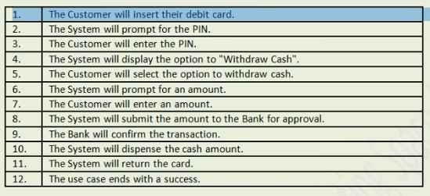
Example 3: ATM Withdraw Cash
Normal Work Flow for withdrawing cash:

Slide 12
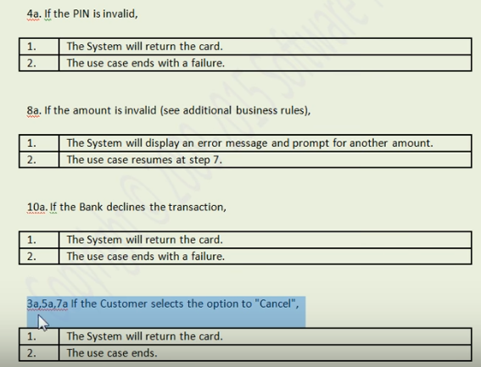
Example 3: ATM Withdraw Cash
Extensions:

Slide 13
Example 3: ATM Withdraw Cash
Additional Business rule:
The system will dispense a maximum of $100 in a single transaction
Post conditions:
The system will receive their cash amount.
Now do Use Case Testing
Review the use case whether the requirements are complete or not
Review the Exceptions workflows whether they are complete or not.

Slide 14
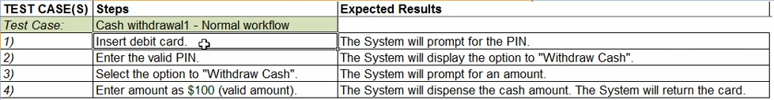
Example 3: ATM Withdraw Cash
Test Cases for Normal Workflow:
Likewise write test cases for each exception defined earlier

Slide 15
Advantages and Disadvantages of Use Case based testing
Advantages:
User focused, because testing is done by user perspective
This testing type helps in covering all the possible flows that the
actors are likely to take. So better coverage.
Reduces time in test case design.
Disadvantages:
If any flow or use case is missing in the use case document, it will also
have an impact on the testing process.
Not suitable for non-functional requirements

